Slide 1
SharePoint APIs
PnP PowerShell

Slide 3
How to View This Presentation
To switch to Notes Page view:
While in edit mode, click the View tab within the ribbon, and then click Notes Page
To navigate through notes, use the Page Up and Page Down keys
Zoom in or zoom out, if required
In the Notes Page view, you can:
Read any supporting text—now or after the delivery
Add notes to your copy of the presentation, if required
Take the presentation files home with you

Slide 4
Overview
What is PnP PowerShell
In this Lesson
How to use PnP PowerShell
When to use PnP PowerShell

Slide 5
Objectives
Learn what PnP PowerShell is
Get familiar with how to get it
Know when to use it for your customizations
Discover how it can be used

Slide 6

What is PnP PowerShell?
PowerShell Module for SharePoint
Developed under the Patterns and Practices initiative
Open Source under MIT license
Retrieves data through the SharePoint Client Side Object Model (CSOM) using PnP Core CSOM
It does not contain all the functionality that is exposed through the server-side SharePoint PowerShell Snap-in
https://github.com/SharePoint/PnP-PowerShell
Notes:
The Patterns and Practices PowerShell Module was created to help developers and administrators by allowing to leverage all the functionality exposed through the SharePoint Client Side Object Model (CSOM) through the familiar PowerShell syntax. This makes it ideal for automation.
Licensed under MIT means it can freely be used for any purpose, both commercial as well as private without having to pay any fees as long as the original disclaimer is copied along in the code.
As it leverages CSOM, it works both for on premises SharePoint 2013, 2016 and 2019 installations as well as SharePoint Online tenants. It can be used both on the server in an on premises scenario as well as from another machine over normal HTTP(S) traffic towards SharePoint Online or an on premises SharePoint farm.
It’s feature set is rich and getting updated on a monthly base, but still not as rich as everything you can do through the server-side SharePoint PowerShell Snap-In which comes with and only works with on premises SharePoint farms.

Slide 7
When to Use PnP PowerShell
Automate deployments
Easily and quickly configure SharePoint components
Validate SharePoint settings
When having no desktop or remoting access to the SharePoint farm (i.e. SharePoint Online)
Applying PnP Provisioning Templates
Notes:
If you want to automate repeating tasks, PnP PowerShell is ideal. I.e. think about provisioning new sites and placing components on it directly.
Another practical usage of PnP PowerShell is to use it to i.e. clean lists from growing too large. Or set rights on multiple components within sites. Or configure settings that aren’t available through the web interface of SharePoint, like setting JSViews or adding JavaScript CustomAction ScriptLinks to inject code into every page in the classic experience. Also looking at or modifying property bags on i.e. webs is possible through PnP PowerShell.
You could also use it to validate certain SharePoint settings easily. Just to see if they’re still set to what you expect them to be or i.e. generate automated reports on who has access to what.
When you don’t have access to the (remote) desktop of a SharePoint farm server nor you have PowerShell remoting access to it, as is the case with SharePoint Online, PnP PowerShell offers you a good option to work with the familiar PowerShell syntax remotely to connect to your SharePoint environment.
Another really popular component is the PnP Provisioning Templates which can perfectly used from PnP PowerShell.

Slide 8
How to Install PnP PowerShell
Download MSI package
Install through Install-Module (recommended)
SharePoint Version | Command to install
SharePoint Online | Install-Module SharePointPnPPowerShellOnline
SharePoint 2019 | Install-Module SharePointPnPPowerShell2019
SharePoint 2016 | Install-Module SharePointPnPPowerShell2016
SharePoint 2013 | Install-Module SharePointPnPPowerShell2013
Updating the modules can be done using:
Update-Module SharePointPnPPowerShell*
Notes:
The PnP PowerShell MSI packages is a good alternative if the host does not have internet access and can be found at:
https://github.com/SharePoint/PnP-PowerShell/releases
Install through Install-Module is available on Windows platforms having PowerShell 3.0 or later on Windows 7 or Windows 2008R2 or later versions.
Source: https://docs.microsoft.com/en-us/powershell/module/powershellget/install-module?view=powershell-5.1
PnP PowerShell has monthly release cycles and sometimes even during a month an intermedia release is presented. To update your installed version in case of using the MSI: just download the latest MSI and run the setup. It will automatically replace the current version. In the scenario of having used Install-Module, simply run Update-Module SharePointPnPPowerShell* to update all your PnP PowerShell modules to the latest version.
Notice that for each SharePoint version, a separate library exist. You MUST use the proper library with the proper SharePoint version you are connecting to. It is possible to install multiple of these libraries at the same time on the same machine. In that case ensure you explicitly load the right SharePoint PnP PowerShell library yourself before executing any PnP PowerShell commands using Import-Module SharePointPnPPowerShell2019. By that you ensure that the right library is being used.

Slide 9
How to Use PnP PowerShell
Connect to a SharePoint environment using i.e.: Connect-PnPOnline -Url https://<sharepoint sitecol>
Execute the command you wish, i.e.:
Connect-PnPOnline -Url https://contoso.sharepoint.com -UseWebLogin
Get-PnPList -List "Documents" | Get-PnPListItem
Add-PnPFile -FileName sample.docx -Folder "Documents"
Notes:
To use PnP PowerShell you first connect to a sitecollection using i.e.:
Connect-PnPOnline -Url https://dev.contoso.local -CurrentCredentials
If you provide the -UseWebLogin, you will get an interactive webdialog where you can provide credentials. This also allows deviating from your current domain credentials and using two factor authentication. If you omit –UseWebLogin you will get a simple username/password dialog box. This type of login does not support two factor authentication, if applicable. Yet another option is to provide the -CurrentCredentials flag which will attempt to log you on using your current domain credentials allowing single sign on if your PC is in the same domain as your SharePoint farm.
The specific sample shown on this slide will connect to the Contoso SharePoint Online environment using an interactive weblogon, will then list all documents available in the Documents document library and ends by uploading the file sample.docx from your local machine to the Documents document library.

Slide 10
Get-Command
Get all available commands using:
Get-Command –Module SharePointPnPPowerShell*
Notes:
Once connected, you can use any of the PnP PowerShell commands. To get an overview of the available commands, execute:
Get-Command -Module SharePointPnPPowerShell*
The chart shows how many cmdlets each of the SharePoint options have available. You can see that the Microsoft.SharePoint.PowerShell PSSnapin by far still contains most options. PnP PowerShell is trying hard to catch up and the official PowerShell module for SharePoint Online lacks behind with way less cmdlets.
Numbers measured with the March 2020 release of PnP PowerShell 2019 version, SharePoint 2019 on-premises farm patched with the December 2019 CU and version 16.0.19814.12000 of the Microsoft.Online.SharePoint.PowerShell PowerShell module.

Slide 11
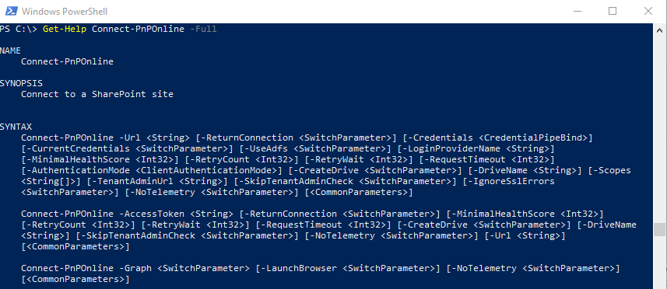
Get-Help
Get documentation on a specific command using:
Get-Help <cmdlet> -Full
Notes:
To get help on a specific command how to use it, simply use the standard Get-Help <cmdlet> -Full option. Most cmdlets have detailed descriptions and several samples to help you get started.

Slide 12
Authentication (1/2)
PnP PowerShell allows many ways to authenticate
Using a web browser to log on Connect-PnPOnline –Url https://dev.contoso.local -UseWebLogin
Using a Generic Windows Credential named https://dev.contoso.local Connect-PnPOnline –Url https://dev.contoso.local
Using a simple username/password dialog Connect-PnPOnline -Url https://dev.contoso.local -Credentials (Get-Credential)
Using the current user credentials Connect-PnPOnline -Url https://dev.contoso.local -CurrentCredentials
Using a specifically named Generic Windows Credential Connect-PnPOnline -Url https://dev.contoso.local -Credentials “MySharePoint”
Notes:
If you have to go through a browser based flow to authenticate to your SharePoint farm, i.e. with two factor authentication or ADFS, this option will allow you to do that and return the logged on token once you complete your login to PnP PowerShell
This option allows you to store the URL you are connecting to in the Windows Credential Manager using a Generic Windows Credential named similarly as the URL you are connecting to. When connecting, PnP PowerShell will automatically try to authenticate using the credentials stored in the Windows Credential Manager. This does not work if an interactive authentication flow like with two factor authentication is required.
If you simply authenticate to SharePoint using an username and password without any interactive logon like two factor authentication or ADFS, this method will show you a simple dialog where you can enter your username and password to authenticate
If you want to use the credentials with which you’re currently logged on to your machine to authenticate to SharePoint as well, you can use this option
This option allows you to specify the name of the Windows Credential Manager Generic Windows Credential yourself to use to authenticate to SharePoint. This allows you to reuse the same credential set over different site collections.

Slide 13
Authentication (2/2)
Using an App-Only OAuth Low Trust Connect-PnPOnline -Url https://dev.contoso.local -AppId 24121c4f-75de-4c57-9b2c-3d2276932a97 -AppSecret Fgtl…Ii/LQ=
Using an App-Only OAuth High Trust (On-Premises Only) Connect-PnPOnline -Url https://dev.contoso.local -HighTrustCertificatePath c:\HighTrustAppCert.pfx -HighTrustCertificateIssuerId d9083880-7ea5-46ee-be07-3b3e9eee0d59 -ClientId f1e58c27-b931-46e6-8850-114e46895dd5 -HighTrustCertificatePassword "Pass@word1“ And many more… Get-Help Connect-PnPOnline -Examples
Notes:
If you’re using Forms Based Authentication with your on premises SharePoint farm, you can provide your credentials in a simple username/password dialog which will then pass the credentials on to the Forms Based Authentication provider
If you wish to use an OAuth trust based on a low trust, you can use this syntax. OAuth with SharePoint will be discussed in a later module.
If you wish to use an OAuth trust based on a high trust, which only is applicable to SharePoint On Premises, this syntax can be used. OAuth with SharePoint will be discussed in a later module.

Slide 14
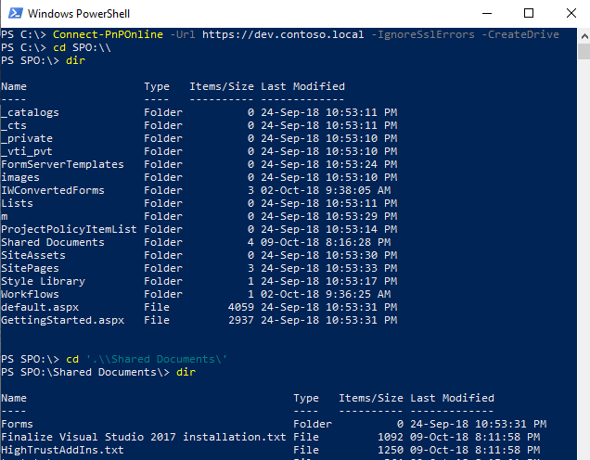
Browsing SharePoint like a local file system
Traverse through the SharePoint structure
Connect using the CreateDrive argument: Connect-PnPOnline -Url https://dev.contoso.local -CreateDrive
Notes:
You can navigate through SharePoint as if it would be your local file system. In order to do so you need to provide the –CreateDrive argument to any of the available authentication methods having been discussed in the previous slides. This will create a virtual drive SPO: within that PowerShell session. By switching to this virtual drive you can go through the entire structure as if it would be your local file system. This includes the use of commands like Rename-Item and Copy-Item to work with files in i.e. document libraries.

Slide 15
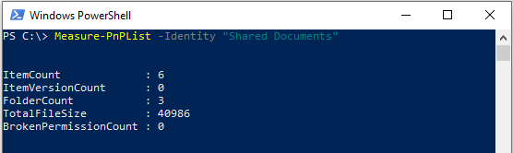
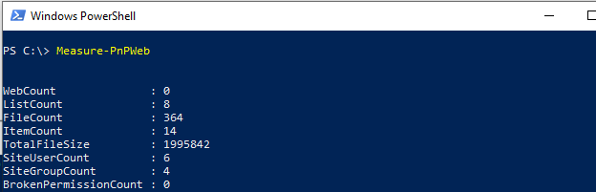
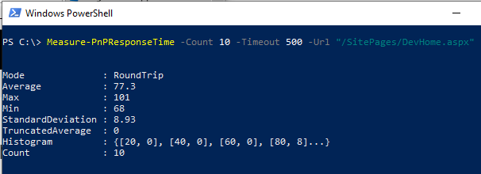
Measure Commands
Can be used to measure:
Items in a list
Total file size of libraries
Amount of subsites
Amount of lists
Amount of users
Response time of a page
Etc…
Notes:
PnP PowerShell a the time of writing (October 2018) has three measure commands built into it. The three are shown on this slide along with their output. These can be very handy in troubleshooting issues or finding things like large lists or where the storage quota of your site is being used up.

Slide 16
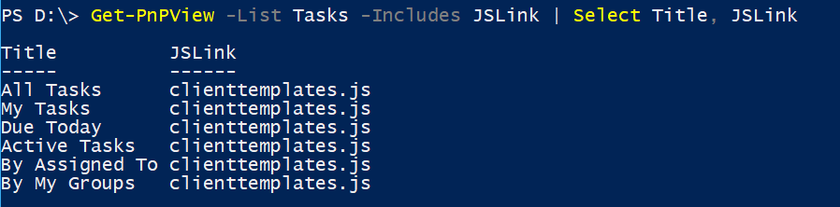
Working with JSLink on a View
Getting and setting JSLink on a View
Get-PnPView -List Tasks -Includes JSLink | Select Title, JSLink
Set-PnPView -List Tasks -Identity "All Tasks" -Values @{JSLink = "clienttemplates.js|test.js"}
Notes:
This sample shows how you can first request all JSLinks to be shown that are connected to all views of the Tasks list. Then it shows how you can chain another, in this case test.js, JSLink file to the All Tasks view on the Tasks list so it influences the way the items will be rendered when the end user opens the All Tasks view on the Tasks list. Notice that we keep the original clienttemplates.js attached to that view as well, so we only enrich it with i.e. functionality to render the progress column differently.

Slide 17
Knowledge Check
Can PnP PowerShell connect to a SharePoint farm from another machine
Which PowerShell option offers most capabilities
What is the PowerShell command to connect to a site collection
Microsoft.SharePoint.PowerShell Snap-in
PnP PowerShell Module
SharePoint Online Module
Yes
Connect-PnPOnline -Url <sitecollection URL>

Slide 18
Lesson Summary
PnP PowerShell leverages the SharePoint CSOM library
PnP PowerShell allows configuring a SharePoint environment using easy to use PowerShell syntax
PnP PowerShell can be used to automate repetitive tasks and set properties that are not available through the web interface

Slide 19
Questions?

Slide 20
Lab: Working with PnP PowerShell
In this lab you are going to perform various operations against SharePoint using PnP PowerShell. You get to work with a variety of authentication options and commands for automating tasks.
Time estimation: 60 minutes
Notes:
The lab contents are located in the folder “Lab - Working with PnP PowerShell”

Slide 21
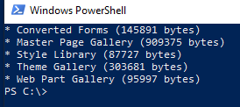
Bonus exercise: Working with PnP PowerShell
Write a PowerShell command which will use PnP PowerShell to return a list of all document libraries in a site that have more than 50,000 bytes of data stored in them.
Time estimation: 20 minutes
Notes:
There is no Lab manual for this exercise. All information is provided on this sheet. Only challenge your students with this bonus exercise if they are proficient in PowerShell or they will never make it. You may want to offer this to students who were very fast with completing the previous lab while others are still working on it. You may also choose to skip this entirely if you already used a lot of time on the previous lab. It’s up to you.
There are multiple ways to achieve this goal. One of them is with this one-line of PowerShell:
Get-PnPList | ? BaseType -eq DocumentLibrary | % { $ml = Measure-PnPList -Identity $_.Title; if($ml.TotalFileSize -gt 50000) { Write-Output $("* " + $_.Title + " (" + $ml.TotalFileSize + " bytes)") }}
This exercise is meant for the students to find their way in the available commands and try to combine them. Depending on the level of knowledge on PowerShell in your class you may want to push your students in the right direction by telling them about Get-PnPList to get all lists, hint that they have to find a way to filter them to just document libraries and then can use the Measure-PnPList command to get the total file size. That should give them enough to figure this out. Ask students that mention to have solved it to present their solution to the class.

